Slide 1
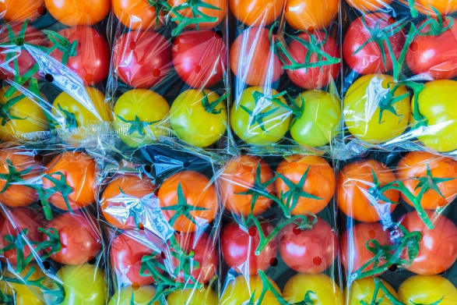
HOW TO REDUCE WASTE?
TOP 10 TIPS
1. Use your own bag
2. Avoid excessive plastic packaging.
3. Say no to plastic straws.
4. Use glass jars for storage.
5. Carry a reusable bottle.

Slide 2
6. Sort, recyle and compost.
7. Repair and reuse products.
8. Know the rules of recycling.
9. Cancel unnecessary mail.
10. Donate used items.

